Slide 1
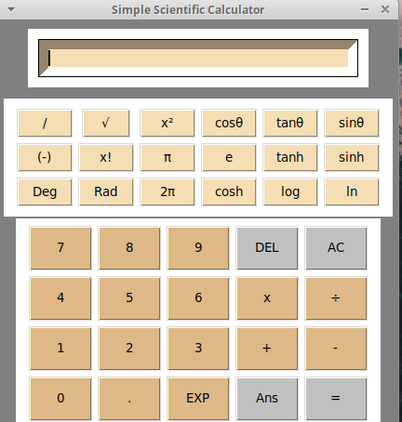
Simple Scientific Calculator
Nomsa and Joselyn

Slide 2
Introduction
Our Simple Scientific Calculator is a Python-based graphical user interface (GUI) program.
It allows users to perform various mathematical operations, including basic arithmetic and scientific calculations.
The calculator provides both standard and scientific input options for enhanced functionality.

Slide 3
Brief look into our calculator
Tkinter:
- Standard GUI library for Python.
- Used to create graphical user interfaces.
- Builds the calculator's GUI elements.
Math Library:
- Python's built-in `math` library.
- Performs various mathematical calculations.
- Used for square roots, trigonometric functions, etc.
Threading:
- Used Python's `threading` module.
- Enables multithreading for responsive GUI.
- Runs time-consuming calculations in separate threads.
OOP:
- Follows OOP principles
- Encapsulates functionality in the `Calculator` class.
- Organizes code for maintainability.
Tkinter Widgets:
- Various Tkinter widgets: `Frame`, `Button`, `Entry`.
- Create the calculator's GUI layout.
- Enables user interactions.
Lambda Functions:
- Anonymous functions used for button commands.
- Links specific mathematical operations with calculator buttons.

Slide 4

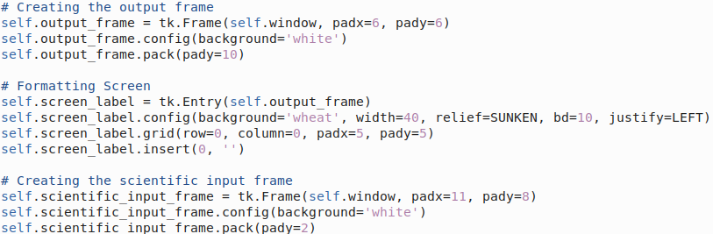
OOP Principles
1. Encapsulation:
- Use of the class: `Calculator`
- Encapsulates functionality and GUI elements.
- Promotes better code organization.
2. Abstraction:
- Users interact with defined methods.
- Calculator behaviour hidden from main code.
-Eg. When clicks square root button and ‘math.sqrt()’ is used.
3. Modularity:
- Breaks functionality into manageable units.
- Each button corresponds to a separate method.
- Easy to add/modify buttons without affecting the code.
Some instances we used these OOP Principles:
Calculator class:
Lambda Functions:
.
Formatting Frames and Widgets:
Example: self.output_frame, self.scientific_input_frame,
self.standard_input_frame

Slide 5
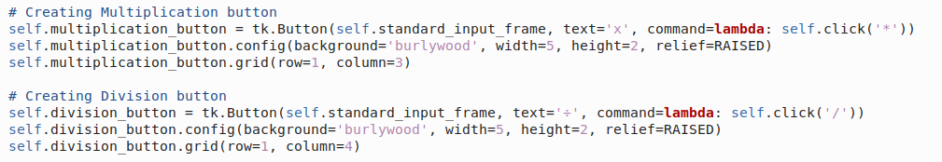

Standard Functions
The standard functions are executed using the ‘click’ method.
The ‘click’ method evaluates the current expression and performs the corresponding operation based on the buttons clicked. It serves as the brain of the calculator receiving user inputs, executing appropriate operations and updating the screen label to provide a responsive and functional calculator interface.

Slide 6

Why multithreading?
Some instances where we used multithreading
Okay, you get the idea 😆
- Multithreading is used in this code to boost the responsiveness of the calculator's graphical interface during scientific calculations.
- Implementation:
- The `multithread()` method enables multithreading for scientific functions.
- When a scientific button is clicked, the `multithread()` method is called instead of executing the calculation directly.
- Benefits:
- Independent Execution: Scientific calculations run in a separate thread, avoiding GUI freezing.
- Smooth User Experience: Complex scientific calculations don't impact the interface's smoothness.

Slide 7

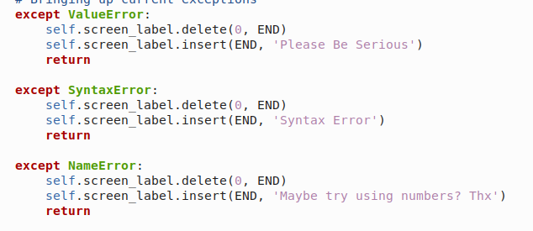
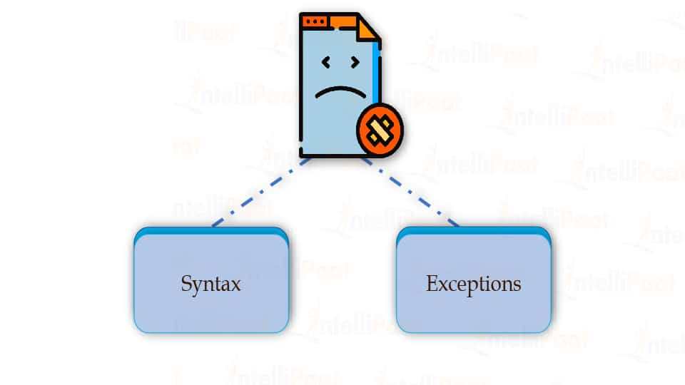
Handling Exceptions
The exceptions we handled:
1. Purpose:
- Ensure a better user experience.
- Prevent crashes and confusing error messages.
- Validate user input for mathematical expressions.
2. Benefits
- Application remains stable and responsive.
3. Implementation:
- `try-except` blocks used for handling exceptions.
4. Preventing Crashes:
- Avoid abrupt application crashes due to errors.
- Keep the application running smoothly.

Slide 8
New Technologies
According to what we DID NOT do in CST1500
Tkinter
Use of Math Library
Lambda Functions
Exception Handling

Slide 9
Demo Time.

Slide 10
THE END.

